Slide 1
Seedling Abundance by Vegetation Type
Christiana Quinata
EEB698 Final Presentation

Slide 2
Introduction
Are there more seedling/sapling abundance in native vegetation vs. degraded vegetation (degraded limestone and vitex forest)

Slide 3
Methods
How did you test your question?
Vegetation Transect Survey (plant community data)
Glm
Family = Poisson
Plant count data per transect and vegetation type

Slide 4
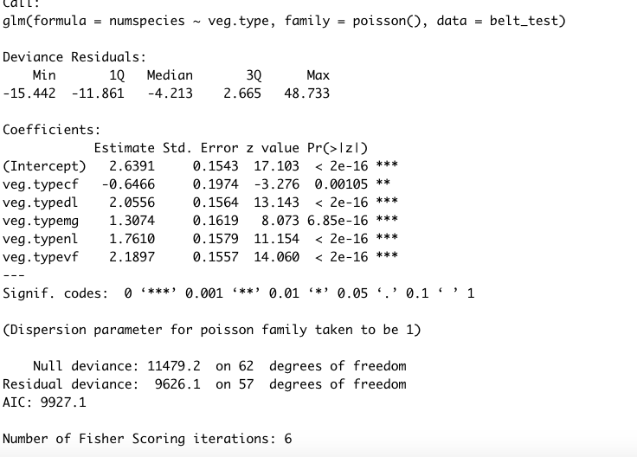
Analysis

Slide 5
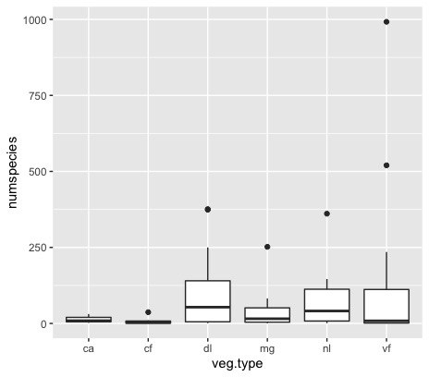
Results

Slide 6
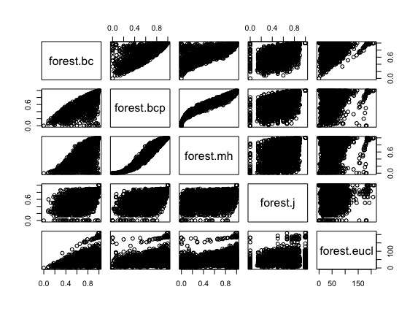
Discussion

